Slide 1
Heroes of Computing
Module C.7

Slide 2
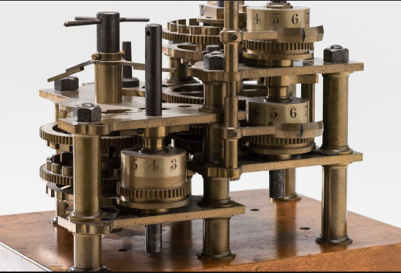
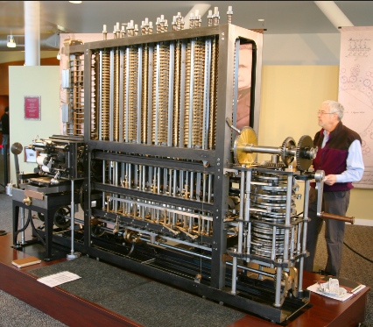
Charles Babbage
The Difference Engine (1820)
Mechanical Calculator
Solves Polynomials
Using Differences (e.g. of Squares)

Slide 3
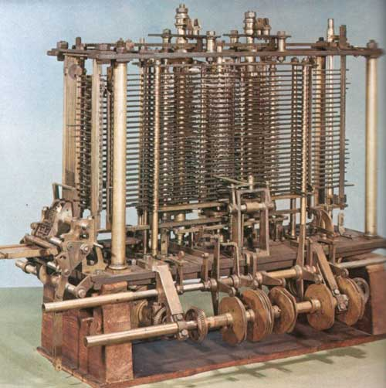
Ada Lovelace
The Analytical Engine (1840)
Updated Version of the Difference Engine
General Purpose Calculator
Solves Many Problems
Uses Flexible “logic”

Slide 4
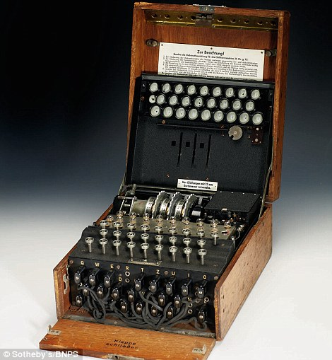
Alan Turing
The Enigma (WWII)
Encrypted Code used by the Germans for secret communications
Code was “cracked” by the British
Using the first electronic computer
Main reason for winning the war
Enigma Code Machine Used by the Germans

Slide 5
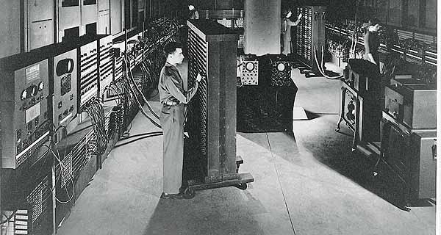
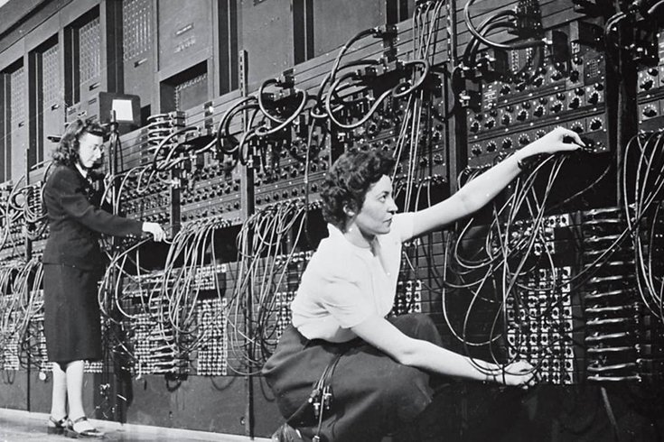
John von Neumann
The ENIAC Computer (1946)
One of the first “Modern” Computers
All Electronic
General Purpose
“von Neumann” Machine
Uses a Stored Program – Software for Flexible Operation
Replaces Hard Wired – Program is created by reconnecting wires

Slide 6
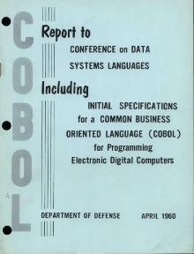
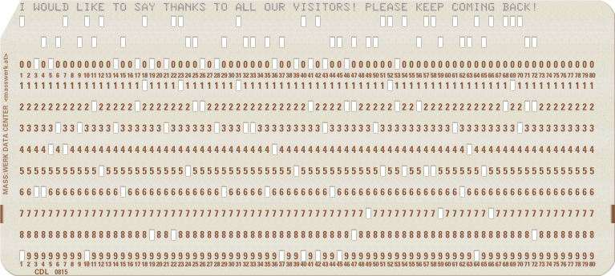
Grace Hopper
The COBOL Language(1959)
One of the first High Level Computer Languages
Uses Plain English (rather than complicated codes or numbers)
Allows for Portable Programming (same program may be used on multiple computer types)
COmmon-Business-Oriented-Language
Still a preferred language used by Banks, Insurance Companies and other Financial Institutions
Works well with Databases and large Mainframe Computers

Slide 7
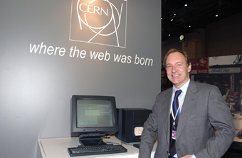

Tim Berners-Lee
The World Wide Web (1989)
Maybe you’ve heard of it?
Originally Developed To Share Scientific Ideas
Free for anyone to use
Based on Public Open Standards
Not owned by any country or company

